Slide 1
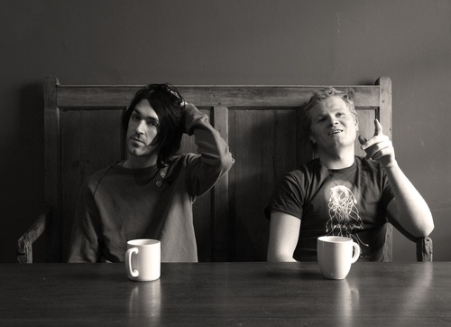
Duologues & sCENES
Drama
Year 9
Lesson 5 Rehearsals

Slide 2

LESSON AIM
To rehearse your scenes and identify areas which can be improved upon.

Slide 3

LESSON OUTCOME
LEVEL 4 – I will know I can rehearse my scene.
LEVEL 5 – I will understand I can rehearse my scene and identify areas which need improvement.
LEVEL 6 – I will be able to rehearse my scene, identify areas which need improvement and be able to refine my performance.

Slide 4
Matthew, Mark, Luke & John (FOCUS)
All students sit in a straight line and are numbered, except for Matthew, Mark, Luke & John who sit sideways to create an ‘L’ shape.
The game is played to a beat, smack on knees, clap of hands, click (right hand), click (left hand).
Matthew starts and says his name on first click and someone else(or number) on second click.
Whoever has had there name or numbered called must take on the call at the next click and continue game.
i.e Matthew to 4, 4 to John, John to Matthew, Matthew to 9, 9 to 7 etc etc
If a player makes a mistake or calls off beat they must go to the bottom of the line and all the players move up a seat.

Slide 5
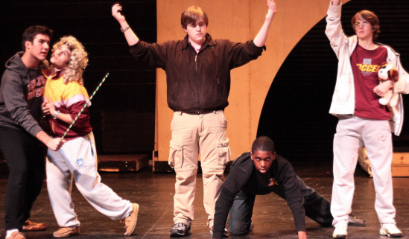
REHEARSALS
REMEMBER...
Staging
Stay In Role
Stay On Task
Characterisation
Use of words
Energy
Enjoy yourself...but work hard

Slide 6

CIRCLE TIME
Sit in whole class circle.
Feedback on the process of your group.

Slide 7
What have you achieved today? LESSON OUTCOME
LEVEL 4 – I will know I can rehearse my scene.
LEVEL 5 – I will understand I can rehearse my scene and identify areas which need improvement.
LEVEL 6 – I will be able to rehearse my scene, identify areas which need improvement and be able to refine my performance.

Slide 8
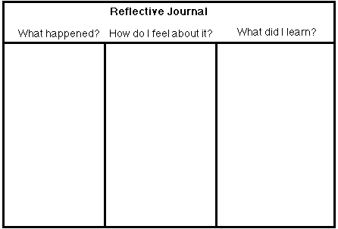
REFLECTIVE LOG
It is important to reflect on every lesson and begin thinking about setting targets for yourselves. For assessment it is important to keep a log book of activities, so you must write a reflective log for each lesson.

